Slide 1

Remedies Towards Breaching The Memory Wall for Sparse Computations
Mert Hidayetoglu¹, Leopold Grinberg², Constantinos Evangelinos², Jinjun Xiong², and Wen-mei W. Hwu¹
¹University of Illinois at Urbana-Champaign
²IBM T. J. Watson Research Center
Coordinated
Science
Laboratory

Slide 2
Memory Wall
Coordinated
Science
Laboratory

Slide 3
Roofline Model
//SPMV
for(int m = 0; m < nump; m++){
double reduce = 0;
for(int n = displ[m]; n < displ[m+1]; n++)
reduce += value[n]*x[index[n]];
y[m] = reduce;
}
Coordinated
Science
Laboratory

Slide 4
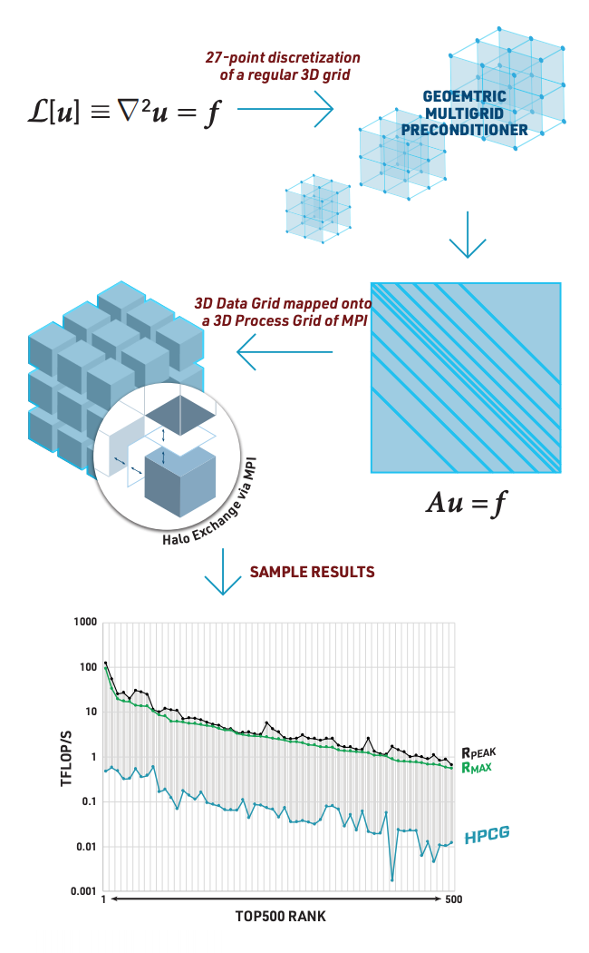
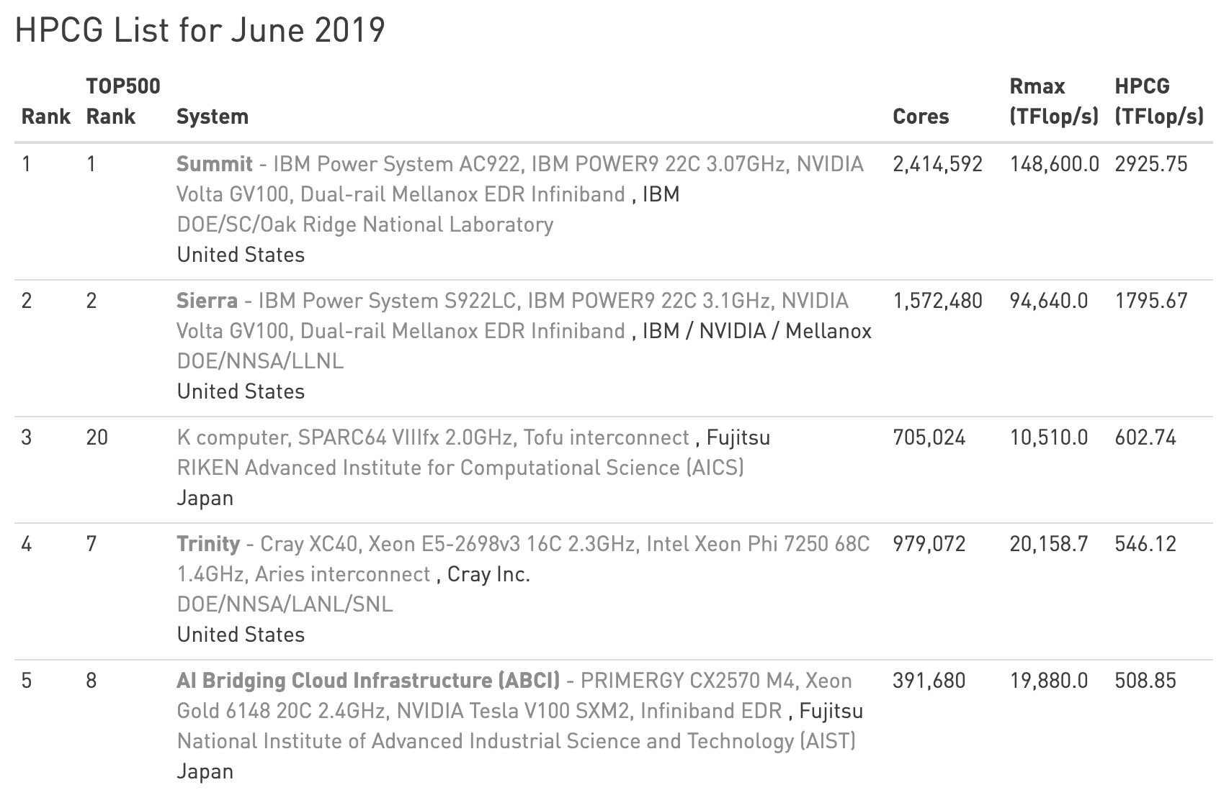
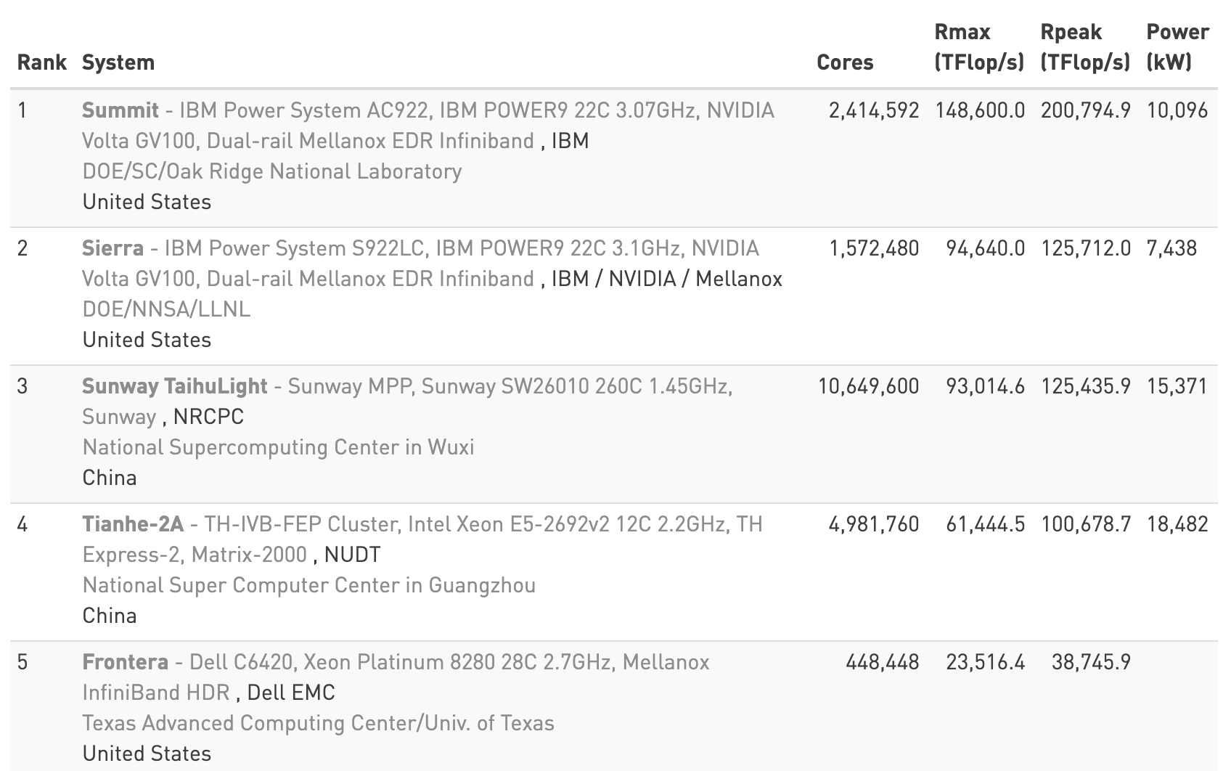
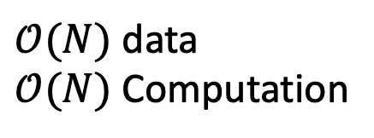
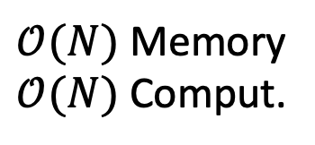
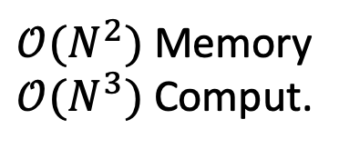
HPCG
$𝒪(N)$ data
$𝒪(N)$ Computation
Sparse data
Low FLOPS
Stresses memory syst.
$𝒪(N)$ Memory
$𝒪(N)$ Comput.
LINPACK
www.top500.org
Dense data
High FLOPS
Stresses processors
$𝒪(N^{2})$ Memory
$𝒪(N^{3})$ Comput.
www.hpcg-benchmark.org
www.top500.org

Slide 5
Computational Kernels in Each Iteration
Other HPCG Operations
//GAUSS-SEIDEL FORWARD SWEEP
for(int m = 0; m < nump; m++){
double reduce = b[m];
for(int n = displ[m]; n < displ[m+1]; n++)
reduce -= value[n]*x[index[n]];
x[m] += reduce/diag[m];
}
Inherently Sequential
Other HPCG Operations
//GAUSS-SEIDEL BACKWARD SWEEP
for(int m = nump-1; m > -1; m--){
double reduce = b[m];
for(int n = displ[m+1]-1; n > displ[m]-1; n--)
reduce -= value[n]*x[index[n]];
x[m] += reduce/diag[m];
}
//SPMV
for(int m = 0; m < nump; m++){
double reduce = 0;
for(int n = displ[m]; n < displ[m+1]; n++)
reduce += value[n]*x[index[n]];
y[m] = reduce;
}
Inherently Sequential
Easily Parallelized
Other HPCG Operations
Coordinated
Science
Laboratory

Slide 6
Batching Algorithm
Row-Major Order
Batch 0 (1)
root
0
0
1
2
3
4
5
5
Frontier Nodes
6
7
8
9
10
11
11
Unvisited Nodes
12
13
14
15
16
17
Connection Visit
18
19
20
21
22
23
17
24
25
26
27
28
29
23
30
31
32
33
34
35
29
35
Batch Size: 10
Coordinated
Science
Laboratory

Slide 7
Batching Algorithm
Row-Major Order
Batch 0 (2)
root
0
0
1
2
3
4
5
5
Frontier Nodes
6
7
8
9
10
11
11
Unvisited Nodes
12
13
14
15
16
17
Connection Visit
18
19
20
21
22
23
17
24
25
26
27
28
29
23
30
31
32
33
34
35
29
35
Batch Size: 10
Coordinated
Science
Laboratory

Slide 8
Batching Algorithm
Row-Major Order
Batch 0 (3)
root
0
0
1
2
3
4
5
5
Frontier Nodes
6
7
8
9
10
11
11
Unvisited Nodes
12
13
14
15
16
17
Connection Visit
18
19
20
21
22
23
17
24
25
26
27
28
29
23
30
31
32
33
34
35
29
35
Batch Size: 10
Coordinated
Science
Laboratory

Slide 9
Batching Algorithm
Row-Major Order
Batch 0 (4)
root
0
0
1
2
3
4
5
5
Frontier Nodes
6
7
8
9
10
11
11
Unvisited Nodes
12
13
14
15
16
17
Connection Visit
18
19
20
21
22
23
17
24
25
26
27
28
29
23
30
31
32
33
34
35
29
35
Batch Size: 10
Coordinated
Science
Laboratory

Slide 10
Batching Algorithm
Row-Major Order
Batch 0 (4)
root
0
0
1
2
3
4
5
5
Frontier Nodes
6
7
8
9
10
11
11
Unvisited Nodes
12
13
14
15
16
17
Connection Visit
18
19
20
21
22
23
17
24
25
26
27
28
29
23
30
31
32
33
34
35
29
35
Batch Size: 10
Coordinated
Science
Laboratory

Slide 11
Batching Algorithm
Row-Major Order
Batch 0 (5)
root
0
0
1
2
3
4
5
5
Frontier Nodes
6
7
8
9
10
11
11
Unvisited Nodes
12
13
14
15
16
17
Connection Visit
18
19
20
21
22
23
17
24
25
26
27
28
29
23
30
31
32
33
34
35
29
35
Batch Size: 10
Coordinated
Science
Laboratory

Slide 12
Batching Algorithm
Row-Major Order
Batch 0 (6)
root
0
0
1
2
3
4
5
5
Frontier Nodes
6
7
8
9
10
11
11
Unvisited Nodes
12
13
14
15
16
17
Connection Visit
18
19
20
21
22
23
17
24
25
26
27
28
29
23
30
31
32
33
34
35
29
35
Batch Size: 10
Coordinated
Science
Laboratory

Slide 13
Batching Algorithm
Row-Major Order
Batch 0 (7)
root
0
0
1
2
3
4
5
5
Frontier Nodes
6
7
8
9
10
11
11
Unvisited Nodes
12
13
14
15
16
17
Connection Visit
18
19
20
21
22
23
17
24
25
26
27
28
29
23
30
31
32
33
34
35
29
35
Batch Size: 10
Coordinated
Science
Laboratory

Slide 14
Batching Algorithm
Row-Major Order
Batch 0 (8)
root
0
0
1
2
3
4
5
5
Frontier Nodes
6
7
8
9
10
11
11
Unvisited Nodes
12
13
14
15
16
17
Connection Visit
18
19
20
21
22
23
17
24
25
26
27
28
29
23
30
31
32
33
34
35
29
35
Batch Size: 10
Coordinated
Science
Laboratory

Slide 15
Batching Algorithm
Row-Major Order
Batch 0 (9)
root
0
0
1
2
3
4
5
5
Frontier Nodes
6
7
8
9
10
11
11
Unvisited Nodes
12
13
14
15
16
17
Connection Visit
18
19
20
21
22
23
17
24
25
26
27
28
29
23
30
31
32
33
34
35
29
35
Batch Size: 10
Coordinated
Science
Laboratory

Slide 16
Batching Algorithm
Row-Major Order
Batch 0 (9)
root
0
0
1
2
3
4
5
5
Frontier Nodes
6
7
8
9
10
11
11
Unvisited Nodes
12
13
14
15
16
17
Connection Visit
18
19
20
21
22
23
17
24
25
26
27
28
29
23
30
31
32
33
34
35
29
35
Batch Size: 10
Coordinated
Science
Laboratory

Slide 17
Batching Algorithm
Row-Major Order
Batch 0 (10)
root
0
0
1
2
3
4
5
5
Frontier Nodes
6
7
8
9
10
11
11
Unvisited Nodes
12
13
14
15
16
17
Connection Visit
18
19
20
21
22
23
17
24
25
26
27
28
29
23
30
31
32
33
34
35
29
35
Batch Size: 10
Coordinated
Science
Laboratory

Slide 18
Batching Algorithm
Row-Major Order
Batch 0 (10)
root
0
0
1
2
3
4
5
5
Frontier Nodes
6
7
8
9
10
11
11
Unvisited Nodes
12
13
14
15
16
17
Connection Visit
18
19
20
21
22
23
17
24
25
26
27
28
29
23
30
31
32
33
34
35
29
35
Batch Size: 10
Coordinated
Science
Laboratory

Slide 19
Batching Algorithm
Row-Major Order
Batch 0 (10)
Batch 1 (1)
0
0
1
2
3
4
5
root
5
Frontier Nodes
6
7
8
9
10
11
11
Unvisited Nodes
12
13
14
15
16
17
Connection Visit
18
19
20
21
22
23
17
24
25
26
27
28
29
23
30
31
32
33
34
35
29
35
Batch Size: 10
Coordinated
Science
Laboratory

Slide 20
Batching Algorithm
Row-Major Order
Batch 0 (10)
Batch 1 (10)
0
0
1
2
3
4
5
5
Frontier Nodes
6
7
8
9
10
11
11
Unvisited Nodes
12
13
14
15
16
17
Connection Visit
18
19
20
21
22
23
17
root
24
25
26
27
28
29
23
30
31
32
33
34
35
29
Batch 2 (1)
35
Batch Size: 10
Coordinated
Science
Laboratory

Slide 21
Batching Algorithm
Row-Major Order
Batch 0 (10)
Batch 1 (10)
0
0
1
2
3
4
5
5
Frontier Nodes
6
7
8
9
10
11
11
Unvisited Nodes
12
13
14
15
16
17
Connection Visit
18
19
20
21
22
23
17
24
25
26
27
28
29
root
23
30
31
32
33
34
35
29
Batch 2 (10)
Batch 3 (1)
35
Batch Size: 10
Coordinated
Science
Laboratory

Slide 22
Batching Algorithm
Row-Major Order
Batch 0 (10)
Batch 1 (10)
0
0
1
2
3
4
5
5
Frontier Nodes
6
7
8
9
10
11
11
Unvisited Nodes
12
13
14
15
16
17
Connection Visit
18
19
20
21
22
23
17
24
25
26
27
28
29
23
30
31
32
33
34
35
29
Batch 2 (10)
Batch 3 (6)
35
root
Batch Size: 10
Coordinated
Science
Laboratory

Slide 23

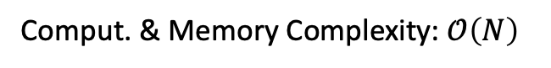
IDEA: Reorder to increase cache reuse
Comput. & Memory Complexity: $𝒪\left(N\right)$
Row-Major Order
Batch Reordering
Batch 0
Batch 1
Batch 0
Batch 1
0
0
0
1
2
3
4
5
0
1
2
3
10
11
5
5
6
7
8
9
10
11
4
5
6
12
13
14
12
13
14
15
16
17
11
7
8
9
15
16
17
11
18
19
20
21
22
23
17
20
21
18
19
30
31
17
24
25
26
27
28
29
23
22
23
24
25
32
33
23
30
31
32
33
34
35
26
27
28
29
34
35
29
29
Batch 2
Batch 3
Batch 2
Batch 3
35
35
dummy extension
Batch Size: 10
Batch Size: 10
Coordinated
Science
Laboratory

Slide 24

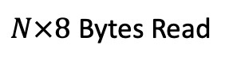


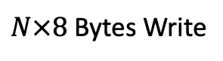


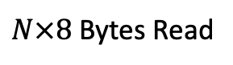


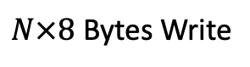
Memory Transactions
Original HPCG Gauss-Seidel
Auxiliary Data: $3N×8$ Bytes Read
Matrix Data: $27N×(8+4)$ Bytes Read
//GAUSS-SEIDEL FORWARD SWEEP
for(int m = 0; m < nump; m++){
double reduce = b[m];
for(int n = displ[m]; n < displ[m+1]; n++)
reduce -= value[n]*x[index[n]];
x[m] += reduce/diag[m];
}
Vector Data: $27N×8$ Bytes Read
Irregular Access
$N×8$ Bytes Read
$N×8$ Bytes Write
Gauss-Seidel with Reordering
Memory Transactions
//GAUSS-SEIDEL FORWARD SWEEP
for(int m = 0; m < nump; m++){
double reduce = b[m];
for(int n = displ[m]; n < displ[m+1]; n++)
reduce -= value[n]*x[index[n]];
x[m] += reduce/diag[m];
}
Auxiliary Data: $3N×8$ Bytes Read
Matrix Data: $27N×(8+4)$ Bytes Read
Vector Data: $27N×8$ Bytes Read
Maximum cache-reuse: $27$
$N×8$ Bytes Read
$N×8$ Bytes Write
No kernel code change!
IDEA: Use a buffer for explicit vector data reuse
IDEA: Use short index to save memory B/W

Slide 25
Cache-Miss Rate Simulation
(for single-level and single-line cache)
POWER9 Specs
L1: 32 KB per Core
L2: 512 KB per Core
L3: 120 MB per Chip
Batch Size = 1 means no reordering
Coordinated
Science
Laboratory

Slide 26
Cache-Miss Rate Simulation vs. Time Measurements
220x220x220 Grid with 27-Point Stencil
Time Measurement on Summit
L2 Miss-Rate Simulation
Very Good Match!!!
Coordinated
Science
Laboratory

Slide 27
Matrix Sparsity Pattern
6x6x6 27-point stencil
Batch Size: 25
Original
Batch Reordering
Coordinated
Science
Laboratory

Slide 28
Buffering Algorithm
0
//GAUSS-SEIDEL FORWARD SWEEP
for(int batch = 0; batch < numbatch; batch++){
//READ MAPPING DATA
int mapnz = mapdispl[batch+1]-mapdispl[batch];
int start = mapdispl[batch];
//ALLOCATE BUFFER
double buffer[batchsize+mapnz];
//LOAD INTER-BATCH DATA
for(int n = 0; n < mapnz; n++)
buffer[batchsize+n] = x[map[start+n]];
//LOAD INTRA-BATCH DATA
start = batch*batchsize;
for(int n = 0; n < batchsize; n++)
buffer[n] = x[start+n];
//PERFORM GAUSS-SEIDEL PER BATCH
for(int m = start; m < start+batchsize; m++){
double reduce = b[m];
for(int n = displ[m]; n < displ[m+1]; n++)
reduce -= value[n]*buffer[sndex[n]];
buffer[m-start] += reduce/diag[m];
}
//WRITE-BACK INTRA-BATCH DATA
for(int m = 0; m < batchsize; m++)
x[start+m] = buffer[m];
}
0
1
2
3
10
11
5
4
5
6
12
13
14
7
8
9
15
16
17
11
20
21
18
19
30
31
17
22
23
24
25
32
33
23
26
27
28
29
34
35
29
35
Coordinated
Science
Laboratory

Slide 29
Buffering Algorithm
Data Accessed by Batch 0
0
//GAUSS-SEIDEL FORWARD SWEEP
for(int batch = 0; batch < numbatch; batch++){
//READ MAPPING DATA
int start = mapdispl[batch];
int mapnz = mapdispl[batch+1]-start;
//ALLOCATE BUFFER
double buffer[batchsize+mapnz];
//LOAD INTER-BATCH DATA
for(int n = 0; n < mapnz; n++)
buffer[batchsize+n] = x[map[start+n]];
//LOAD INTRA-BATCH DATA
start = batch*batchsize;
for(int n = 0; n < batchsize; n++)
buffer[n] = x[start+n];
//PERFORM GAUSS-SEIDEL PER BATCH
for(int m = start; m < start+batchsize; m++){
double reduce = b[m];
for(int n = displ[m]; n < displ[m+1]; n++)
reduce -= value[n]*buffer[sndex[n]];
buffer[m-start] += reduce/diag[m];
}
//WRITE-BACK INTRA-BATCH DATA
for(int m = 0; m < batchsize; m++)
x[start+m] = buffer[m];
}
0
1
2
3
10
11
5
4
5
6
12
13
14
7
8
9
15
16
17
11
20
21
18
19
30
31
17
22
23
24
25
32
33
23
26
27
28
29
34
35
29
35
Coordinated
Science
Laboratory

Slide 30
Buffering Algorithm
Data Accessed by Batch 0
0
//GAUSS-SEIDEL FORWARD SWEEP
for(int batch = 0; batch < numbatch; batch++){
//READ MAPPING DATA
int start = mapdispl[batch];
int mapnz = mapdispl[batch+1]-start;
//ALLOCATE BUFFER
double buffer[batchsize+mapnz];
//LOAD INTER-BATCH DATA
for(int n = 0; n < mapnz; n++)
buffer[batchsize+n] = x[map[start+n]];
//LOAD INTRA-BATCH DATA
start = batch*batchsize;
for(int n = 0; n < batchsize; n++)
buffer[n] = x[start+n];
//PERFORM GAUSS-SEIDEL PER BATCH
for(int m = start; m < start+batchsize; m++){
double reduce = b[m];
for(int n = displ[m]; n < displ[m+1]; n++)
reduce -= value[n]*buffer[sndex[n]];
buffer[m-start] += reduce/diag[m];
}
//WRITE-BACK INTRA-BATCH DATA
for(int m = 0; m < batchsize; m++)
x[start+m] = buffer[m];
}
0
1
2
3
10
11
5
Temporary
Buffer
4
5
6
12
13
14
7
8
9
15
16
17
11
20
21
18
19
30
31
17
22
23
24
25
32
33
23
26
27
28
29
34
35
29
35
Coordinated
Science
Laboratory

Slide 31
Buffering Algorithm
Load inter-batch data
Irregular Access
Hardly Vectorizable
Requires a mapping (additional overhead)
Data Accessed by Batch 0
0
//GAUSS-SEIDEL FORWARD SWEEP
for(int batch = 0; batch < numbatch; batch++){
//READ MAPPING DATA
int start = mapdispl[batch];
int mapnz = mapdispl[batch+1]-start;
//ALLOCATE BUFFER
double buffer[batchsize+mapnz];
//LOAD INTER-BATCH DATA
for(int n = 0; n < mapnz; n++)
buffer[batchsize+n] = x[map[start+n]];
//LOAD INTRA-BATCH DATA
start = batch*batchsize;
for(int n = 0; n < batchsize; n++)
buffer[n] = x[start+n];
//PERFORM GAUSS-SEIDEL PER BATCH
for(int m = start; m < start+batchsize; m++){
double reduce = b[m];
for(int n = displ[m]; n < displ[m+1]; n++)
reduce -= value[n]*buffer[sndex[n]];
buffer[m-start] += reduce/diag[m];
}
//WRITE-BACK INTRA-BATCH DATA
for(int m = 0; m < batchsize; m++)
x[start+m] = buffer[m];
}
0
1
2
3
10
11
5
Temporary
Buffer
4
5
6
12
13
14
7
8
9
15
16
17
11
20
21
18
19
30
31
17
22
23
24
25
32
33
23
26
27
28
29
34
35
29
35
Coordinated
Science
Laboratory

Slide 32
Buffering Algorithm
Load intra-batch data
Regular Access
Vectorizable
Data Accessed by Batch 0
0
//GAUSS-SEIDEL FORWARD SWEEP
for(int batch = 0; batch < numbatch; batch++){
//READ MAPPING DATA
int start = mapdispl[batch];
int mapnz = mapdispl[batch+1]-start;
//ALLOCATE BUFFER
double buffer[batchsize+mapnz];
//LOAD INTER-BATCH DATA
for(int n = 0; n < mapnz; n++)
buffer[batchsize+n] = x[map[start+n]];
//LOAD INTRA-BATCH DATA
start = batch*batchsize;
for(int n = 0; n < batchsize; n++)
buffer[n] = x[start+n];
//PERFORM GAUSS-SEIDEL PER BATCH
for(int m = start; m < start+batchsize; m++){
double reduce = b[m];
for(int n = displ[m]; n < displ[m+1]; n++)
reduce -= value[n]*buffer[sndex[n]];
buffer[m-start] += reduce/diag[m];
}
//WRITE-BACK INTRA-BATCH DATA
for(int m = 0; m < batchsize; m++)
x[start+m] = buffer[m];
}
0
1
2
3
10
11
5
Temporary
Buffer
4
5
6
12
13
14
7
8
9
15
16
17
11
20
21
18
19
30
31
17
22
23
24
25
32
33
23
26
27
28
29
34
35
29
35
Coordinated
Science
Laboratory

Slide 33
Buffering Algorithm
Perform Gauss-Seidel from buffer
Intra-Batch Data is Updated
Data Accessed by Batch 0
0
//GAUSS-SEIDEL FORWARD SWEEP
for(int batch = 0; batch < numbatch; batch++){
//READ MAPPING DATA
int start = mapdispl[batch];
int mapnz = mapdispl[batch+1]-start;
//ALLOCATE BUFFER
double buffer[batchsize+mapnz];
//LOAD INTER-BATCH DATA
for(int n = 0; n < mapnz; n++)
buffer[batchsize+n] = x[map[start+n]];
//LOAD INTRA-BATCH DATA
start = batch*batchsize;
for(int n = 0; n < batchsize; n++)
buffer[n] = x[start+n];
//PERFORM GAUSS-SEIDEL PER BATCH
for(int m = start; m < start+batchsize; m++){
double reduce = b[m];
for(int n = displ[m]; n < displ[m+1]; n++)
reduce -= value[n]*buffer[index[n]];
buffer[m-start] += reduce/diag[m];
}
//WRITE-BACK INTRA-BATCH DATA
for(int m = 0; m < batchsize; m++)
x[start+m] = buffer[m];
}
0
1
2
3
10
11
5
Temporary
Buffer
4
5
6
12
13
14
7
8
9
15
16
17
11
20
21
18
19
30
31
17
22
23
24
25
32
33
23
26
27
28
29
34
35
29
35
Coordinated
Science
Laboratory

Slide 34
Buffering Algorithm
Write-back intra-batch data
Regular Access
Vectorizable
Data Accessed by Batch 0
0
//GAUSS-SEIDEL FORWARD SWEEP
for(int batch = 0; batch < numbatch; batch++){
//READ MAPPING DATA
int start = mapdispl[batch];
int mapnz = mapdispl[batch+1]-start;
//ALLOCATE BUFFER
double buffer[batchsize+mapnz];
//LOAD INTER-BATCH DATA
for(int n = 0; n < mapnz; n++)
buffer[batchsize+n] = x[map[start+n]];
//LOAD INTRA-BATCH DATA
start = batch*batchsize;
for(int n = 0; n < batchsize; n++)
buffer[n] = x[start+n];
//PERFORM GAUSS-SEIDEL PER BATCH
for(int m = start; m < start+batchsize; m++){
double reduce = b[m];
for(int n = displ[m]; n < displ[m+1]; n++)
reduce -= value[n]*buffer[index[n]];
buffer[m-start] += reduce/diag[m];
}
//WRITE-BACK INTRA-BATCH DATA
for(int m = 0; m < batchsize; m++)
x[start+m] = buffer[m];
}
0
1
2
3
10
11
5
Temporary
Buffer
4
5
6
12
13
14
7
8
9
15
16
17
11
20
21
18
19
30
31
17
22
23
24
25
32
33
23
26
27
28
29
34
35
29
35
Coordinated
Science
Laboratory

Slide 35
Buffering Algorithm
Data Accessed by Batch 1
0
//GAUSS-SEIDEL FORWARD SWEEP
for(int batch = 0; batch < numbatch; batch++){
//READ MAPPING DATA
int start = mapdispl[batch];
int mapnz = mapdispl[batch+1]-start;
//ALLOCATE BUFFER
double buffer[batchsize+mapnz];
//LOAD INTER-BATCH DATA
for(int n = 0; n < mapnz; n++)
buffer[batchsize+n] = x[map[start+n]];
//LOAD INTRA-BATCH DATA
start = batch*batchsize;
for(int n = 0; n < batchsize; n++)
buffer[n] = x[start+n];
//PERFORM GAUSS-SEIDEL PER BATCH
for(int m = start; m < start+batchsize; m++){
double reduce = b[m];
for(int n = displ[m]; n < displ[m+1]; n++)
reduce -= value[n]*buffer[index[n]];
buffer[m-start] += reduce/diag[m];
}
//WRITE-BACK INTRA-BATCH DATA
for(int m = 0; m < batchsize; m++)
x[start+m] = buffer[m];
}
0
1
2
3
10
11
5
Temporary
Buffer
4
5
6
12
13
14
7
8
9
15
16
17
11
20
21
18
19
30
31
17
22
23
24
25
32
33
23
26
27
28
29
34
35
29
35
Coordinated
Science
Laboratory

Slide 36
Buffering Algorithm
0
//GAUSS-SEIDEL FORWARD SWEEP
for(int batch = 0; batch < numbatch; batch++){
//READ MAPPING DATA
int start = mapdispl[batch];
int mapnz = mapdispl[batch+1]-start;
//ALLOCATE BUFFER
double buffer[batchsize+mapnz];
//LOAD INTER-BATCH DATA
for(int n = 0; n < mapnz; n++)
buffer[batchsize+n] = x[map[start+n]];
//LOAD INTRA-BATCH DATA
start = batch*batchsize;
for(int n = 0; n < batchsize; n++)
buffer[n] = x[start+n];
//PERFORM GAUSS-SEIDEL PER BATCH
for(int m = start; m < start+batchsize; m++){
double reduce = b[m];
for(int n = displ[m]; n < displ[m+1]; n++)
reduce -= value[n]*buffer[index[n]];
buffer[m-start] += reduce/diag[m];
}
//WRITE-BACK INTRA-BATCH DATA
for(int m = 0; m < batchsize; m++)
x[start+m] = buffer[m];
}
0
1
2
3
10
11
5
Temporary
Buffer
4
5
6
12
13
14
7
8
9
15
16
17
11
20
21
18
19
30
31
17
22
23
24
25
32
33
23
26
27
28
29
34
35
29
Data Accessed by Batch 2
35
Coordinated
Science
Laboratory

Slide 37
Buffering Algorithm
0
//GAUSS-SEIDEL FORWARD SWEEP
for(int batch = 0; batch < numbatch; batch++){
//READ MAPPING DATA
int start = mapdispl[batch];
int mapnz = mapdispl[batch+1]-start;
//ALLOCATE BUFFER
double buffer[batchsize+mapnz];
//LOAD INTER-BATCH DATA
for(int n = 0; n < mapnz; n++)
buffer[batchsize+n] = x[map[start+n]];
//LOAD INTRA-BATCH DATA
start = batch*batchsize;
for(int n = 0; n < batchsize; n++)
buffer[n] = x[start+n];
//PERFORM GAUSS-SEIDEL PER BATCH
for(int m = start; m < start+batchsize; m++){
double reduce = b[m];
for(int n = displ[m]; n < displ[m+1]; n++)
reduce -= value[n]*buffer[index[n]];
buffer[m-start] += reduce/diag[m];
}
//WRITE-BACK INTRA-BATCH DATA
for(int m = 0; m < batchsize; m++)
x[start+m] = buffer[m];
}
0
1
2
3
10
11
5
Temporary
Buffer
4
5
6
12
13
14
7
8
9
15
16
17
11
20
21
18
19
30
31
17
22
23
24
25
32
33
23
26
27
28
29
34
35
29
Data Accessed by Batch 3
35
Coordinated
Science
Laboratory

Slide 38
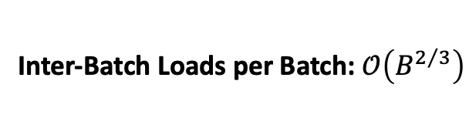
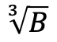
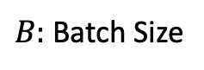
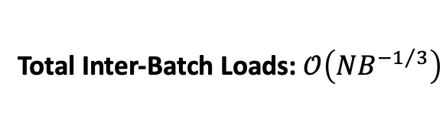
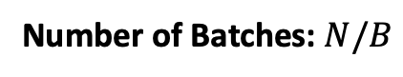
//GAUSS-SEIDEL FORWARD SWEEP
for(int batch = 0; batch < numbatch; batch++){
//READ MAPPING DATA
int start = mapdispl[batch];
int mapnz = mapdispl[batch+1]-start;
//ALLOCATE BUFFER
double buffer[batchsize+mapnz];
//LOAD INTER-BATCH DATA
for(int n = 0; n < mapnz; n++)
buffer[batchsize+n] = x[map[start+n]];
//LOAD INTRA-BATCH DATA
start = batch*batchsize;
for(int n = 0; n < batchsize; n++)
buffer[n] = x[start+n];
//PERFORM GAUSS-SEIDEL PER BATCH
for(int m = start; m < start+batchsize; m++){
double reduce = b[m];
for(int n = displ[m]; n < displ[m+1]; n++)
reduce -= value[n]*buffer[index[n]];
buffer[m-start] += reduce/diag[m];
}
//WRITE-BACK INTRA-BATCH DATA
for(int m = 0; m < batchsize; m++)
x[start+m] = buffer[m];
}
$B:$ Batch Size
Overhead Analysis
Inter-Batch Loads per Batch: $𝒪\left(B^{2/3}\right)$
Number of Batches: $N/B$
$$\sqrt[3]{B}$$
Total Inter-Batch Loads: $𝒪\left(NB^{−1/3}\right)$
These are Irregular Access!
Measured # of Buffer Loads
Good Match!!!

Slide 39
Cache-Miss Rate Simulation
(for single-level and single-line cache)
220x220x220 Grid with 27-Point Stencil
Time Measurement on Summit
L2 Miss-Rate Simulation
POWER9 Specs
L1: 32 KB per Core
L2: 512 KB per Core
L3: 120 MB per Chip
Buffer Larger Than L2 Cache
Simulation Breaks Down
Coordinated
Science
Laboratory

Slide 40


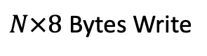

Using Small Buffer
Memory Transactions
//GAUSS-SEIDEL FORWARD SWEEP
for(int batch = 0; batch < numbatch; batch++){
//READ MAPPING DATA
int start = mapdispl[batch];
int mapnz = mapdispl[batch+1]-start;
//ALLOCATE BUFFER
double buffer[batchsize+mapnz];
//LOAD INTER-BATCH DATA
for(int n = 0; n < mapnz; n++)
buffer[batchsize+n] = x[map[start+n]];
//LOAD INTRA-BATCH DATA
start = batch*batchsize;
for(int n = 0; n < batchsize; n++)
buffer[n] = x[start+n];
//PERFORM GAUSS-SEIDEL PER BATCH
for(int m = start; m < start+batchsize; m++){
double reduce = b[m];
for(int n = displ[m]; n < displ[m+1]; n++)
reduce -= value[n]*buffer[sndex[n]];
buffer[m-start] += reduce/diag[m];
}
//WRITE-BACK INTRA-BATCH DATA
for(int m = 0; m < batchsize; m++)
x[start+m] = buffer[m];
}
Auxiliary Data: $3N×8$ Bytes Read
Matrix Data: $27N×(8+2)$ Bytes Read
17% B/W Saving
Vector Data: $N×8$ Bytes Read
Irregular Access Eliminated
$N×8$ Bytes Write
Theoretical Speedup: 17%
Measured Time
Measured Speedup: 17.6%
Use unsigned short instead of int
Very Good Match!!!

Slide 41
Preliminary Results on Summit Node
Grid Size: 220x220x220
Grid Size: 128x128x128
Grid Size: 64x64x64
Grid Size: 60x60x60
Speedup: 17.6%
Speedup: 19.3%
Speedup: 15.7%
Speedup: 13.0%
Coordinated
Science
Laboratory

Slide 42
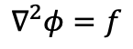
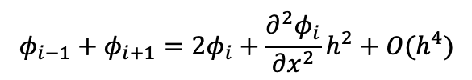
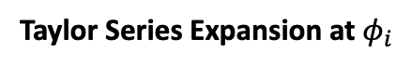
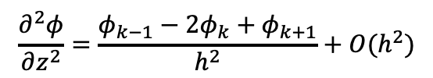
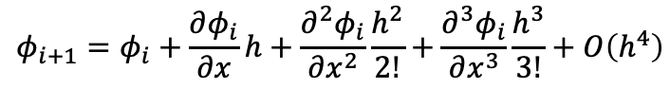
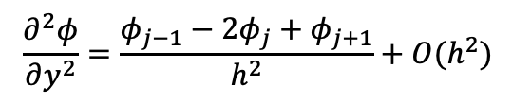
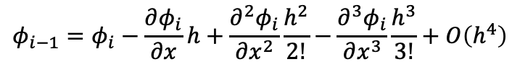
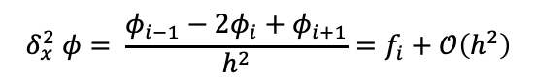
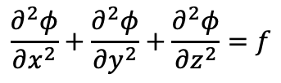
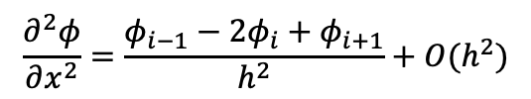
Verification: Solving Poisson Equation
$$∇^{2}φ=f$$
$$\frac{∂^{2}φ}{∂x^{2}}+\frac{∂^{2}φ}{∂y^{2}}+\frac{∂^{2}φ}{∂z^{2}}=f$$
Taylor Series Expansion at $φ_{i}$
$$φ_{i−1}=φ_{i}−\frac{∂φ_{i}}{∂x}h+\frac{∂^{2}φ_{i}}{∂x^{2}}\frac{h^{2}}{2!}−\frac{∂^{3}φ_{i}}{∂x^{3}}\frac{h^{3}}{3!}+O\left(h^{4}\right)$$
$$φ_{i+1}=φ_{i}+\frac{∂φ_{i}}{∂x}h+\frac{∂^{2}φ_{i}}{∂x^{2}}\frac{h^{2}}{2!}+\frac{∂^{3}φ_{i}}{∂x^{3}}\frac{h^{3}}{3!}+O\left(h^{4}\right)$$
$$φ_{i−1}+φ_{i+1}=2φ_{i}+\frac{∂^{2}φ_{i}}{∂x^{2}}h^{2}+O(h^{4})$$
$$\frac{∂^{2}φ}{∂x^{2}}=\frac{φ_{i−1}−2φ_{i}+φ_{i+1}}{h^{2}}+O(h^{2})$$
3-point Equation:
$$δ_{x}^{2} φ= \frac{φ_{i−1}−2φ_{i}+φ_{i+1}}{h^{2}}=f_{i}+𝒪\left(h^{2}\right)$$
$$\frac{∂^{2}φ}{∂y^{2}}=\frac{φ_{j−1}−2φ_{j}+φ_{j+1}}{h^{2}}+O(h^{2})$$
$$\left[δ_{x}^{2}+δ_{y}^{2}\right]φ=\frac{φ_{i−1}+φ_{j−1}−4φ_{i,j}+φ_{i+1}+φ_{j+1}}{h^{2}}=f_{i,j}+𝒪\left(h^{2}\right)$$
5-point Equation:
$$\frac{∂^{2}φ}{∂z^{2}}=\frac{φ_{k−1}−2φ_{k}+φ_{k+1}}{h^{2}}+O(h^{2})$$
$$\left[δ_{x}^{2}+δ_{y}^{2}+δ_{z}^{2}\right]φ=\frac{φ_{i−1}+φ_{j−1}+φ_{k−1}−6φ_{i,j,k}+φ_{i+1}+φ_{j+1}+φ_{k+1}}{h^{2}}=f_{i,j,k}+𝒪\left(h^{2}\right)$$
7-point Equation:
Coordinated
Science
Laboratory

Slide 43
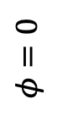
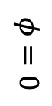
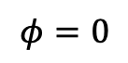
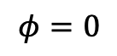
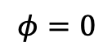
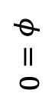
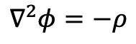
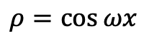
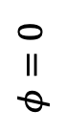
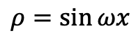
Verification: Solving Poisson Equation with Dirichlet Boundary Conditions
$$∇^{2}φ=−ρ$$
$$φ=0$$
$$ρ=\cos{ωx}$$
$$φ=0$$
$$φ=0$$
$$ρ=\sin{ωx}$$
$$φ=0$$
$$φ=0$$
$$φ=0$$
$$φ=0$$
Coordinated
Science
Laboratory

Slide 44
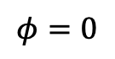

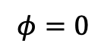

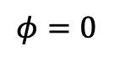
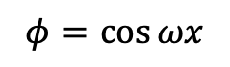
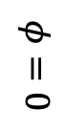



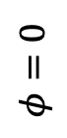

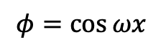
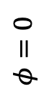


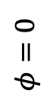
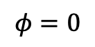
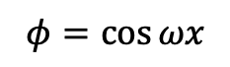
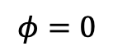
Verification: Solving Poisson Problem with Dirichlet Boundary Conditions
$$φ=0$$
$$φ=0$$
$$∇^{2}φ=0$$
$$∇^{2}φ=0$$
$$φ=0$$
$$φ=1$$
$$φ=0$$
$$φ=0$$
$$φ=0$$
$$φ=\cos{ωx}$$
$$φ=0$$
$$φ=0$$
$$∇^{2}φ=−δ$$
$$∇^{2}φ=0$$
$$φ=0$$
$$φ=1$$
$$φ=0$$
$$φ=1$$
point source
$$φ=\cos{ωx}$$
$$φ=\cos{ωx}$$
Coordinated
Science
Laboratory

Slide 45

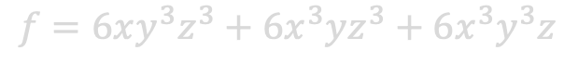











Verification
$$∇φ=f$$
7 Points: $∇_{7}^{2}φ=\left[δ_{x}^{2}+δ_{y}^{2}+δ_{z}^{2}\right]φ=f+𝒪\left(h^{2}\right)$
Function 1:
19 Points:$∇_{19}^{2}φ=\left[∇_{7}^{2}+\frac{h^{2}}{6}\left(δ_{x}^{2}δ_{y}^{2}+δ_{y}^{2}δ_{z}^{2}+δ_{x}^{2}δ_{z}^{2}\right)\right]φ=f+\frac{h^{2}}{12}∇_{7}^{2}f+𝒪\left(h^{4}\right)$
$$φ=xyz$$
$$f=0$$
27 Points:$∇_{27}^{2}φ=\left[∇_{19}^{2}+\frac{h^{4}}{30}\left(δ_{x}^{2}+δ_{y}^{2}+δ_{z}^{2}\right)\right]φ=f+\frac{h^{2}}{12}∇^{2}f+$
$$\frac{h^{4}}{360}∇^{4}f+\frac{h^{4}}{180}\left(\frac{∂^{4}f}{∂x^{2}∂y^{2}}+\frac{∂^{4}f}{∂y^{2}∂z^{2}}+\frac{∂^{4}f}{∂x^{2}∂z^{2}}\right)+𝒪\left(h^{6}\right)$$
Function 2:
$$φ=x^{2}y^{2}z^{2}$$
$$f=2y^{2}z^{2}+2x^{2}z^{2}+2x^{2}y^{2}$$
Function 3:
$$φ=x^{3}y^{3}z^{3}$$
$$f=6xy^{3}z^{3}+6x^{3}yz^{3}+6x^{3}y^{3}z$$
Function 4:
$$φ=\sin\left(x+y+z\right)\cos\left(x+y+z\right)$$
$$f=−6\sin\left(2\left(x+y+z\right)\right)$$
$$∇^{2}f=72\sin\left(2\left(x+y+z\right)\right)$$
$$∇^{4}f=−864\sin\left(2\left(x+y+z\right)\right)$$
$$\frac{∂^{4}f}{∂x^{4}}=\frac{∂^{4}f}{∂y^{4}}=\frac{∂^{4}f}{∂y^{4}}=\frac{∂^{4}f}{∂x^{2}y^{2}}=\frac{∂^{4}f}{∂x^{2}z^{2}}=\frac{∂^{4}f}{∂y^{2}z^{2}}=−96\sin\left(2\left(x+y+z\right)\right)$$
Coordinated
Science
Laboratory

Slide 46


Verification: Forward Problem
$$φ=\sin\left(x+y+z\right)\cos\left(x+y+z\right)$$
$$∇^{2}φ=−6\sin\left(2\left(x+y+z\right)\right)$$
h=dx=dy=dz=1
3x3x3 grid
$$L2={\left(\frac{\sum{e_{i}^{2}}}{N}\right)}^{0.5}$$
$$L0=\max{(|e_{i}|)}$$
Measured Time
$$𝒪\left(h^{4}\right)$$
$$𝒪\left(N\right)$$
$$𝒪\left(N^{2/3}\right)$$
$$𝒪\left(h^{4}\right)$$
$$𝒪\left(h^{2}\right)$$
$$𝒪\left(h^{2}\right)$$
h=dx=dy=dz=1/80
240x240x240 grid
See 7-point, 19-point, and 27-point derivations at: W. F. Spotz and G. F. Carey, “A high-order compact formulation for the 3D Poisson equation,” Numerical Methods for Partial Differential Equations, vol. 12, pp. 235-243, 1996.
Coordinated
Science
Laboratory

Slide 47
Verification: Inverse Problem
6x6x6 h=0.0001
$$∇^{2}φ=−6\sin\left(2\left(x+y+z\right)\right)$$
$$φ=\sin\left(x+y+z\right)\cos\left(x+y+z\right)$$
Coordinated
Science
Laboratory

Slide 48
Verification: Inverse Problem
6x6x6
h=0.001
$$∇^{2}φ=−6\sin\left(2\left(x+y+z\right)\right)$$
$$φ=\sin\left(x+y+z\right)\cos\left(x+y+z\right)$$
Coordinated
Science
Laboratory

Slide 49
Verification: Inverse Problem
6x6x6
h=0.01
$$∇^{2}φ=−6\sin\left(2\left(x+y+z\right)\right)$$
$$φ=\sin\left(x+y+z\right)\cos\left(x+y+z\right)$$
Coordinated
Science
Laboratory

Slide 50
Verification: Inverse Problem
6x6x6
h=0.1
$$∇^{2}φ=−6\sin\left(2\left(x+y+z\right)\right)$$
$$φ=\sin\left(x+y+z\right)\cos\left(x+y+z\right)$$
Coordinated
Science
Laboratory

Slide 51
Verification: Batch Reordering & Buffering Algorithms
6x6x6
h=0.001
$$∇^{2}φ=−6\sin\left(2\left(x+y+z\right)\right)$$
$$φ=\sin\left(x+y+z\right)\cos\left(x+y+z\right)$$
Natural Ordering
Batch Reordering
Batch Size: 25
Coordinated
Science
Laboratory

Slide 52


Verification: Forward Problem
$$φ=xyz$$
60x60x60, h = 0.05, 500 iter.
27-Point Stencil
Plots Shows z = 1.55
$$∇^{2}φ=0$$
7 Points
27 Points
27 Points (HPCG)
Log10 Error
Log10 Error
Log10 Error
max error: 1.45519152284e-11
max error: 1.45519152284e-11
max error: 1.01863406599e-10
Coordinated
Science
Laboratory

Slide 53


Verification: Forward Problem
$$φ=x^{2}y^{2}z^{2}$$
60x60x60, h = 0.05, 500 iter.
27-Point Stencil
Plots Shows z = 1.55
$$∇^{2}φ=2y^{2}z^{2}+2x^{2}z^{2}+2x^{2}y^{2}$$
7 Points
27 Points
27 Points (HPCG)
Log10 Error
Log10 Error
Log10 Error
max error: 1.46788628283e-12
max error: 9.41588553895e-05
max error: 8.00169490195
Coordinated
Science
Laboratory

Slide 54


Verification: Forward Problem
$$φ=x^{3}y^{3}z^{3}$$
60x60x60, h = 0.05, 500 iter.
27-Point Stencil
Plots Shows z = 1.55
$$∇^{2}φ=6xy^{3}z^{3}+6x^{3}yz^{3}+6x^{3}y^{3}z$$
7 Points
27 Points
27 Points (HPCG)
Log10 Error
Log10 Error
Log10 Error
max error: 6.38890550781e-13
max error: 0.000282497842487
max error: 8.00508534414
Coordinated
Science
Laboratory

Slide 55


Verification: Forward Problem
$$φ=\sin\left(x+y+z\right)\cos\left(x+y+z\right)$$
60x60x60, h = 0.05, 500 iter.
27-Point Stencil
Plots Shows z = 1.55
$$∇^{2}φ=−6\sin\left(2\left(x+y+z\right)\right)$$
7 Points
27 Points
27 Points (HPCG)
Log10 Error
Log10 Error
Log10 Error
max error: 0.000833055605171
max error: 0.0024958382399
max error: 7.96258571217
Coordinated
Science
Laboratory

Slide 56










Least Squares: Gradient-Descent Method
$$f\left(x\right)=\frac{1}{2}x^{T}Ax−b^{T}x+c$$
Gradient-Descent Step:
Finding Gradient:
$$d=∇\left(f\right)=r$$
$$f\left(x+d\right)=f\left(x\right)+d^{T}\left(Ax−b\right)+\frac{1}{2}d^{T}Ad$$
$$x←x−d\frac{d^{T}r}{d^{T}Ad}$$
Can be implemented with a single MVM
$$=f\left(x\right)+d^{T}∇f\left(x\right)+O\left(d^{2}\right)$$
$$r←r−Ad\frac{d^{T}r}{d^{T}Ad}$$
$$∇f\left(x\right)=\left(Ax−b\right)=r$$
Finding Step Size:
$$f\left(x+αd\right)=f\left(x\right)+αd^{T}r+α^{2}\frac{1}{2}d^{T}Ad$$
$$\frac{∂f}{∂α}=d^{T}r+ad^{T}Ad=0$$
Sanity Check: step direction has to be orthogonal to the next gradient
$$α=−\frac{d^{T}r}{d^{T}Ad}$$
$$\left\langle d,∇f(x+αd)\right\rangle =d^{T}\left[Ax−Ad\frac{d^{T}r}{d^{T}Ad}−b\right]=d^{T}\left[Ax−b\right]−d^{T}r=0$$
Coordinated
Science
Laboratory

Slide 57


Verification: Inverse Problem
$$∇^{2}φ=0$$
60x60x60, h = 0.05, 500 iter.
27-Point Stencil
Plots Shows z = 1.55
$$φ=xyz$$
Jacobi
Gauss-Seidel
Gradient-Descent
Conjugate-Gradient
Log10 Error
Log10 Error
Log10 Error
Log10 Error
max error: 0.121224243455
max error: 0.0442830865917
max error: 0.076706235115
max error: 7.0836745736e-15
Coordinated
Science
Laboratory

Slide 58


Verification: Inverse Problem
$$∇^{2}φ=2y^{2}z^{2}+2x^{2}z^{2}+2x^{2}y^{2}$$
60x60x60, h = 0.05, 500 iter.
27-Point Stencil
Plots Shows z = 1.55
$$φ=x^{2}y^{2}z^{2}$$
Jacobi
Gauss-Seidel
Gradient-Descent
Conjugate-Gradient
Log10 Error
Log10 Error
Log10 Error
Log10 Error
max error: 0.0347910309115
max error: 0.0106007486994
max error: 0.0195319652925
max error: 1.09441058053e-05
Coordinated
Science
Laboratory

Slide 59


Verification: Inverse Problem
$$∇^{2}φ=6xy^{3}z^{3}+6x^{3}yz^{3}+6x^{3}y^{3}z$$
60x60x60, h = 0.05, 500 iter.
27-Point Stencil
Plots Shows z = 1.55
$$φ=x^{3}y^{3}z^{3}$$
Jacobi
Gauss-Seidel
Gradient-Descent
Conjugate-Gradient
Log10 Error
Log10 Error
Log10 Error
Log10 Error
max error: 0.0128737509551
max error: 0.00342426882486
max error: 0.00661606913659
max error: 2.86034236171e-05
Coordinated
Science
Laboratory

Slide 60


Verification: Inverse Problem
$$∇^{2}φ=−6\sin\left(2\left(x+y+z\right)\right)$$
60x60x60, h = 0.05, 500 iter.
27-Point Stencil
Plots Shows z = 1.55
$$φ=\sin\left(x+y+z\right)\cos\left(x+y+z\right)$$
Jacobi
Gauss-Seidel
Gradient-Descent
Conjugate-Gradient
Log10 Error
Log10 Error
Log10 Error
Log10 Error
max error: 0.0556809398082
max error: 0.0123857890091
max error: 0.0268054493562
max error: 0.00284205543708
Coordinated
Science
Laboratory

Slide 61







Verification: Convergence
$$φ=0$$
220x220x220
7-point equation
$$φ=0$$
$$∇^{2}φ=0$$
$$φ=1$$
$$φ=0$$
$$220\sqrt{3}$$
$$220\sqrt{3}$$
$$220\sqrt{3}$$
Coordinated
Science
Laboratory

Slide 62
Verification: Convergence
$$φ=0$$
220x220x220
7-point equation
$$φ=0$$
$$∇^{2}φ=0$$
$$φ=1$$
ZOOMED!
$$φ=0$$
Roughers
Smoothers
Coordinated
Science
Laboratory

Slide 63



Jacobi
Gauss-Seidel
Top Layer
$$∇^{2}φ=−δ$$
point source at the corner
$$φ=1$$
220x220x220
7-point equation
500 Iterations
$$φ=0$$
Gradient Descent
Conjugate Gradient
Coordinated
Science
Laboratory

Slide 64



Verification: Convergence
$$φ=0$$
60x60x60, h = 0.05
7-point equation
$$φ=1$$
$$∇^{2}φ=−δ$$
$$φ=0$$
$$φ=0$$
Coordinated
Science
Laboratory

Slide 65
Verification: Convergence
$$φ=0$$
60x60x60, h = 0.05
27-point equation (HPCG)
$$φ=1$$
$$∇^{2}φ=−δ$$
$$φ=0$$
$$φ=0$$
Coordinated
Science
Laboratory

Slide 66



Verification: Convergence
$$φ=0$$
60x60x60
7-point equation
$$φ=0$$
$$∇^{2}φ=0$$
$$φ=1$$
ZOOMED!
$$φ=0$$
$$60\sqrt{3}$$
$$60\sqrt{3}$$
$$60\sqrt{3}$$
Coordinated
Science
Laboratory

Slide 67
Jacobi
Gauss-Seidel
Top Layer
$$∇^{2}φ=−δ$$
point source at the corner
$$φ=1$$
60x60x60
7-point equation
500 Iterations
$$φ=0$$
Gradient Descent
Conjugate Gradient
Coordinated
Science
Laboratory

Slide 68
Computational Kernels in Each Iteration
Other HPCG Operations
Other HPCG Operations
Other HPCG Operations
//GAUSS-SEIDEL FORWARD SWEEP
for(int batch = 0; batch < numbatch; batch++){
//READ MAPPING DATA
int start = mapdispl[batch];
int mapnz = mapdispl[batch+1]-start;
//ALLOCATE BUFFER
double buffer[batchsize+mapnz];
//LOAD INTER-BATCH DATA
for(int n = 0; n < mapnz; n++)
buffer[batchsize+n] = x[map[start+n]];
//LOAD INTRA-BATCH DATA
start = batch*batchsize;
for(int n = 0; n < batchsize; n++)
buffer[n] = x[start+n];
//PERFORM GAUSS-SEIDEL PER BATCH
for(int m = start; m < start+batchsize; m++){
double reduce = b[m];
for(int n = displ[m]; n < displ[m+1]; n++)
reduce -= value[n]*buffer[sndex[n]];
buffer[m-start] += reduce/diag[m];
}
//WRITE-BACK INTRA-BATCH DATA
for(int m = 0; m < batchsize; m++)
x[start+m] = buffer[m];
}
//GAUSS-SEIDEL BACKWARD SWEEP
for(int batch = numbatch-1; batch > -1; batch--){
//READ MAPPING DATA
int start = mapdispl[batch];
int mapnz = mapdispl[batch+1]-start;
//ALLOCATE BUFFER
double buffer[batchsize+mapnz];
//LOAD INTER-BATCH DATA
for(int n = 0; n < mapnz; n++)
buffer[batchsize+n] = x[map[start+n]];
//LOAD INTRA-BATCH DATA
start = batch*batchsize;
for(int n = 0; n < batchsize; n++)
buffer[n] = x[start+n];
//PERFORM GAUSS-SEIDEL
for(int m = start+batchsize-1; m > start-1; m--){
double reduce = b[m];
for(int n = displ[m+1]-1; n > displ[m]-1; n--)
reduce -= value[n]*buffer[sndex[n]];
buffer[m-start] += reduce/diag[m];
}
//WRITE-BACK INTRA-BATCH DATA
for(int m = 0; m < batchsize; m++)
x[start+m] = buffer[m];
}
//SPMV
for(int batch = 0; batch < numbatch; batch++){
//READ MAPPING DATA
int start = mapdispl[batch];
int mapnz = mapdispl[batch+1]-start;
//ALLOCATE BUFFER
double buffer[batchsize+mapnz];
//LOAD INTER-BATCH DATA
for(int n = 0; n < mapnz; n++)
buffer[batchsize+n] = x[map[start+n]];
//LOAD INTRA-BATCH DATA
start = batch*batchsize;
for(int n = 0; n < batchsize; n++)
buffer[n] = x[start+n];
//PERFORM SPMV
for(int m = start; m < start+batchsize; m++){
double reduce = 0;
for(int n = displ[m]; n < displ[m+1]; n++)
reduce += value[n]*buffer[sndex[n]];
y[m] = reduce;
}
}
Coordinated
Science
Laboratory

Slide 69
Computational Kernels in Each Iteration
IDEA: G-S can be fused with SpMV to reuse matrix data from cache
Other HPCG Operations
Other HPCG Operations
Other HPCG Operations
//GAUSS-SEIDEL FORWARD SWEEP
for(int batch = 0; batch < numbatch; batch++){
//READ MAPPING DATA
int start = mapdispl[batch];
int mapnz = mapdispl[batch+1]-start;
//ALLOCATE BUFFER
double buffer[batchsize+mapnz];
//LOAD INTER-BATCH DATA
for(int n = 0; n < mapnz; n++)
buffer[batchsize+n] = x[map[start+n]];
//LOAD INTRA-BATCH DATA
start = batch*batchsize;
for(int n = 0; n < batchsize; n++)
buffer[n] = x[start+n];
//PERFORM GAUSS-SEIDEL PER BATCH
for(int m = start; m < start+batchsize; m++){
double reduce = b[m];
for(int n = displ[m]; n < displ[m+1]; n++)
reduce -= value[n]*buffer[sndex[n]];
buffer[m-start] += reduce/diag[m];
}
//WRITE-BACK INTRA-BATCH DATA
for(int m = 0; m < batchsize; m++)
x[start+m] = buffer[m];
}
//GAUSS-SEIDEL BACKWARD SWEEP
for(int batch = numbatch-1; batch > -1; batch--){
//READ MAPPING DATA
int start = mapdispl[batch];
int mapnz = mapdispl[batch+1]-start;
//ALLOCATE BUFFER
double buffer[batchsize+mapnz];
//LOAD INTER-BATCH DATA
for(int n = 0; n < mapnz; n++)
buffer[batchsize+n] = x[map[start+n]];
//LOAD INTRA-BATCH DATA
start = batch*batchsize;
for(int n = 0; n < batchsize; n++)
buffer[n] = x[start+n];
//PERFORM GAUSS-SEIDEL
for(int m = start+batchsize-1; m > start-1; m--){
double reduce = b[m];
for(int n = displ[m+1]-1; n > displ[m]-1; n--)
reduce -= value[n]*buffer[sndex[n]];
buffer[m-start] += reduce/diag[m];
}
//WRITE-BACK INTRA-BATCH DATA
for(int m = 0; m < batchsize; m++)
x[start+m] = buffer[m];
}
//SPMV
for(int batch = 0; batch < numbatch; batch++){
//READ MAPPING DATA
int start = mapdispl[batch];
int mapnz = mapdispl[batch+1]-start;
//ALLOCATE BUFFER
double buffer[batchsize+mapnz];
//LOAD INTER-BATCH DATA
for(int n = 0; n < mapnz; n++)
buffer[batchsize+n] = x[map[start+n]];
//LOAD INTRA-BATCH DATA
start = batch*batchsize;
for(int n = 0; n < batchsize; n++)
buffer[n] = x[start+n];
//PERFORM SPMV
for(int m = start; m < start+batchsize; m++){
double reduce = 0;
for(int n = displ[m]; n < displ[m+1]; n++)
reduce += value[n]*buffer[sndex[n]];
y[m] = reduce;
}
}
Coordinated
Science
Laboratory

Slide 70
Computational Kernels in Each Iteration
Other HPCG Operations
Other HPCG Operations
Other HPCG Operations
//FUSED GAUSS-SEIDEL BACKWARD SWEEP & SPMV
for(int batch = numbatch-1; batch > -1; batch--){
//READ MAPPING DATA
int start = mapdispl[batch];
int mapnz = mapdispl[batch+1]-start;
//ALLOCATE BUFFER
double buffer[batchsize+mapnz];
//LOAD INTER-BATCH DATA
for(int n = 0; n < mapnz; n++)
buffer[batchsize+n] = x[map[start+n]];
//LOAD INTRA-BATCH DATA
start = batch*batchsize;
for(int n = 0; n < batchsize; n++)
buffer[n] = x[start+n];
//PERFORM GAUSS-SEIDEL
for(int m = start+batchsize-1; m > start-1; m--){
double reduce = b[m];
for(int n = displ[m+1]-1; n > displ[m]-1; n--)
reduce -= value[n]*buffer[sndex[n]];
buffer[m-start] += reduce/diag[m];
}
//PERFORM SPMV
for(int mn = spmvdispl[batch]; mn < spmvdispl[batch+1]; mn++){
int m = spmvmap[mn];
double reduce = 0;
for(int n = displ[m]; n < displ[m+1]; n++)
reduce += value[n]*buffer[sndex[n]];
y[m] = reduce;
}
//WRITE-BACK INTRA-BATCH DATA
for(int m = 0; m < batchsize; m++)
x[start+m] = buffer[m];
}
//GAUSS-SEIDEL FORWARD SWEEP
for(int batch = 0; batch < numbatch; batch++){
//READ MAPPING DATA
int start = mapdispl[batch];
int mapnz = mapdispl[batch+1]-start;
//ALLOCATE BUFFER
double buffer[batchsize+mapnz];
//LOAD INTER-BATCH DATA
for(int n = 0; n < mapnz; n++)
buffer[batchsize+n] = x[map[start+n]];
//LOAD INTRA-BATCH DATA
start = batch*batchsize;
for(int n = 0; n < batchsize; n++)
buffer[n] = x[start+n];
//PERFORM GAUSS-SEIDEL PER BATCH
for(int m = start; m < start+batchsize; m++){
double reduce = b[m];
for(int n = displ[m]; n < displ[m+1]; n++)
reduce -= value[n]*buffer[sndex[n]];
buffer[m-start] += reduce/diag[m];
}
//WRITE-BACK INTRA-BATCH DATA
for(int m = 0; m < batchsize; m++)
x[start+m] = buffer[m];
}
Coordinated
Science
Laboratory

Slide 71
To-Do List:
Validate correctness by solving a 3-D Laplace equation
Investigate convergence vs. speedup trade-off
Incorporate kernels into HPCG and validate again
Scale on Summit ???
Coordinated
Science
Laboratory

